Slide 1
Control Plane
Advanced Computer Networks

Slide 2
Data, Control, and Management Planes
 | Data | Control | Management
Time-scale | Packet (nsec) | Event (10 msec to sec) | Human (min to hours)
Tasks | Forwarding, buffering, filtering, scheduling | Routing, signaling | Analysis, configuration
Location | Line-card hardware | Router software | Humans or scripts

Slide 3
Data and Control Planes
Processor
control plane
data plane
Switching
Fabric
Line card
Line card
Line card
Line card
Line card
Line card

Slide 4
Routing vs. Forwarding
Routing: control plane
  Computing paths the packets will follow
  Routers talking amongst themselves
  Individual router creating a forwarding table
Forwarding: data plane
  Directing a data packet to an outgoing link
  Individual router using a forwarding table

Slide 5
Routing Protocols
What does the protocol compute?
  Spanning tree, shortest path, local policy, arbitrary end-to-end paths
What algorithm does the protocol run?
  Spanning-tree construction, distance vector, link-state routing, path-vector routing, source routing, end-to-end signaling
How do routers learn end-host locations?
  Learning/flooding, injecting into the routing protocol, dissemination using a different protocol, and directory server

Slide 6
What Does the Protocol Compute?

Slide 7
Different Ways to Represent Paths
Static model
  What is computed, i.e., what is the outcome
  Not how the (distributed) computation is performed
Trade-offs
  State required to represent the paths
  Efficiency of the resulting paths
  Ability to support multiple paths
  Complexity of computing the paths
  Which nodes are in charge
Applied in different settings
  LAN, intradomain, interdomain

Slide 8
Spanning Tree
One tree that reaches every node
  Single path between each pair of nodes
  No loops, so can support broadcast easily
Disadvantages
  Paths are sometimes long
  Some links are not used at all

Slide 9
Shortest Paths
Shortest path(s) between each pair of nodes
  Separate shortest-path tree rooted at each node
  Minimum hop count or minimum sum of edge weights
Disadvantages
  All nodes need to agree on the link metrics
  Multipath routing is limited to Equal Cost MultiPath

Slide 10
Locally Policy at Each Hop
Locally best path
  Local policy: each node picks the path it likes best
  … among the paths chosen by its neighbors
Disadvantages
  More complicated to configure and model
2 1 d
2 d
2 1 d
2 d
3 2 d
3 4 d
2
3 2 d
3 4 d
2
3
1
1 d
1 2 d
3
1
1 d
1 2 d
4 d
4 d
5 4 d
4
5 4 d
4
5
5
6 4 d
6 5 4 d
d
6 4 d
6 5 4 d
d
6
6

Slide 11
End-to-End Path Selection
End-to-end path selection
  Each node picks its own end to end paths
  … independent of what other paths other nodes use
Disadvantages
  More state and complexity in the nodes
  Hop-by-hop destination-based forwarding is not enough

Slide 12
How to Compute Paths?

Slide 13
Spanning Tree Algorithm
Elect a root
  The switch with the smallest identifier
  And form a tree from there
Algorithm
  Repeatedly talk to neighbors
    “I think node Y is the root”
    “My distance from Y is d”
  Update your information
  based on neighbors
    Smaller id as the root
    Smaller distance d+1
  Don’t use interfaces not
  in the path
root
One hop
Three hops
Used in Ethernet-based LANs

Slide 14
Spanning Tree Example: Switch #4
Switch #4 thinks it is the root
  Sends (4, 0, 4) message to 2 and 7
Switch #4 hears from #2
  Receives (2, 0, 2) message from 2
  … and thinks that #2 is the root
  And realizes it is just one hop away
Switch #4 hears from #7
  Receives (2, 1, 7) from 7
  And realizes this is a longer path
  So, prefers its own one-hop path
  And removes 4-7 link from the tree
1
3
5
2
4
6
7

Slide 15
Shortest-Path Problem
Compute: path costs to all nodes
  From a given source u to all other nodes
  Cost of the path through each outgoing link
  Next hop along the least-cost path to s
2
3
1
1
4
u
2
1
5
4
3
6
s

Slide 16
Link State: Dijkstra’s Algorithm
Flood the topology information to all nodes
Each node computes shortest paths to other nodes
Initialization
Loop
S = {u}
for all nodes v
if (v is adjacent to u)
D(v) = c(u,v)
else D(v) = ∞
add w with smallest D(w) to S
update D(v) for all adjacent v:
D(v) = min{D(v), D(w) + c(w,v)}
until all nodes are in S
Used in OSPF and IS-IS

Slide 17
Link-State Routing Example
2
2
3
1
3
1
1
1
4
4
2
1
2
1
5
5
4
3
4
3
2
2
3
1
3
1
1
1
4
4
2
1
2
1
5
5
4
3
4
3

Slide 18
Link-State Routing Example (cont.)
2
2
3
1
3
1
1
1
4
4
2
1
2
1
5
5
4
3
4
3
2
2
3
1
3
1
1
1
4
4
2
1
2
1
5
5
4
3
4
3

Slide 19
Link State: Shortest-Path Tree
Shortest-path tree from u
Forwarding table at u
v
2
y
link
3
1
1
x
4
v
(u,v)
u
z
2
1
w
(u,w)
5
t
x
(u,w)
w
4
3
y
(u,v)
s
z
(u,v)
s
(u,w)
t
(u,w)

Slide 20
Distance Vector: Bellman-Ford Algo
Define distances at each node x
  d_{x}(y) = cost of least-cost path from x to y
Update distances based on neighbors
  d_{x}(y) = min {c(x,v) + d_{v}(y)} over all neighbors v
v
2
y
3
1
1
x
4
u
z
2
1
5
t
d_{u}(z) = min{c(u,v) + d_{v}(z),
c(u,w) + d_{w}(z)}
w
4
3
s
Used in RIP and EIGRP

Slide 21
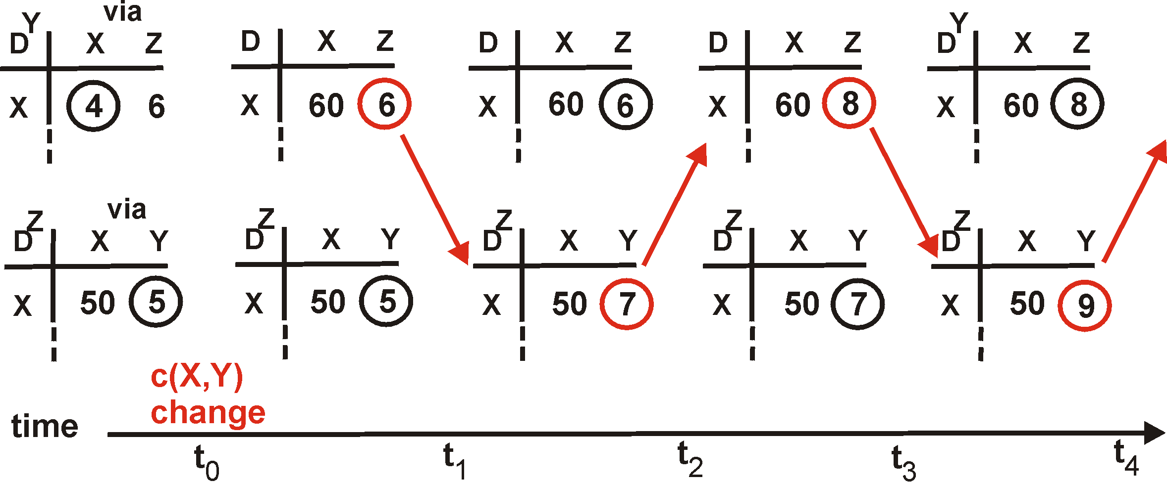
Distance Vector: Count to Infinity
Link cost changes:
Good news travels fast
Bad news travels slow - “count to infinity” problem!
60
Y
4
1
X
Z
50
algorithm
continues
on!

Slide 22

Path-Vector Routing
Extension of distance-vector routing
  Support flexible routing policies
  Avoid count-to-infinity problem
Key idea: advertise the entire path
  Distance vector: send distance metric per dest d
  Path vector: send the entire path for each dest d
“d: path (2,1)”
“d: path (1)”
3
2
1
data traffic
data traffic
d
Used in BGP

Slide 23
Path-Vector: Faster Loop Detection
Node can easily detect a loop
  Look for its own node identifier in the path
  E.g., node 1 sees itself in the path “3, 2, 1”
Node can simply discard paths with loops
  E.g., node 1 simply discards the advertisement
“d: path (2,1)”
“d: path (1)”
3
2
1
“d: path (3,2,1)”

Slide 24
Path-Vector: Flexible Policies
Each node can apply local policies
  Path selection: Which path to use?
  Path export: Which paths to advertise?
Examples
  Node 2 may prefer the path “2, 3, 1” over “2, 1”
  Node 1 may not let node 3 hear the path “1, 2”
2
3
2
3
1
1

Slide 25
End-to-End Signaling
Establish end-to-end path in advance
  Learn the topology (as in link-state routing)
  End host or router computes and signals a path
Routers supports virtual circuits
  Signaling: install entry for each circuit at each hop
  Forwarding: look up the circuit id in the table
1: 7
2: 7
link 7
1: 14
2: 8
1
link 14
2
link 8
Used in MPLS with RSVP

Slide 26
Source Routing
Similar to end-to-end signaling
  But the data packet carries the hops in the path
  … rather than the routers storing big tables
End-host control
  Tell the end host the topology
  Let the end host select the end-to-end path
Variations of source routing
  Strict: specify every hop
  Loose: specify intermediate points
Used in IP source routing (but almost always disabled)

Slide 27
Learning Where the Hosts Are

Slide 28


Finding the Hosts
Building a forwarding table
  Computing paths between network elements
  … and figuring out where the end-hosts are
  … to map a destination address to an outgoing link
How to find the hosts?
  Learning/flooding
  Injecting into the
  routing protocol
  Dissemination using
  a different protocol
  Directory service

Slide 29

Learning and Flooding
When a frame arrives
  Inspect the source address
  Associate address with the incoming interface
When the frame has an unfamiliar destination
  Forward out all interfaces
  … except for the one where the frame arrived
B
B
A
C
A
C
Switch learns how to reach A.
When in doubt, shout!
D
D
Used in Ethernet LANs

Slide 30
Inject into Routing Protocol
Treat the end host (or subnet) as a node
  And disseminate in the routing protocol
  E.g., flood information about where addresses attach
2
3
1
1
4
u
2
1
5
4
3
6
s
Used in OSPF and IS-IS, especially in enterprise networks
. . .

Slide 31


Disseminate With Another Protocol
Distribute using another protocol
  One router learns the route
  … and shares the information with other routers
disseminate route to other routers
learn a route to d
(e.g., via BGP)
Internal BGP (iBGP) used in backbone networks

Slide 32
Directory Service
Contact a service to learn the location
  Lookup the end-host or subnet address
  … and learn the label to put on the packet
  … to get the traffic to the right egress point
directory
e
“Host d is at egress e”
d
i
Used in some data centers.
s
Encapsulate packet to send to egress e.

Slide 33
Conclusion
Routing is challenging
  Distributed computation
  Challenges with scalability and dynamics
Many different solutions for different environments
  Ethernet LAN: spanning tree, MAC learning, flooding
  Enterprise: link-state routing, injecting subnet addresses
  Backbone: link-state routing inside, path-vector routing with neighboring domains, and iBGP dissemination
  Data centers: many different solutions, still in flux
    E.g., link-state routing or multiple spanning trees
    E.g., directory service or injection of subnets into routing protocol

Slide 34
“Design Philosophy of the DARPA Internet Protocols”
(ACM SIGCOMM, 1988)
David Clark

Slide 35
Design Goals
Primary goal
  Effective technique for multiplexed utilization of existing interconnected networks (e.g., ARPAnet, packet radio)
Important goals
  Survivability in the face of failure
  Multiple types of communication service
  Wide variety of network technologies
Less important goals
  Distributed management of resources
  Cost effectiveness
  Host attachment with low level of effort
  Accountability of resources

Slide 36
Consequences of the Goals
Effective multiplexed utilization of existing networks
  Packet switching, not circuit switching
Continued communication despite network failures
  Routers don’t store state about ongoing transfers
  End hosts provide key communication services
Support for multiple types of communication service
  Multiple transport protocols (e.g., TCP and UDP)
Accommodation of a variety of different networks
  Simple, best-effort packet delivery service
  Packets may be lost, corrupted, or delivered out of order
Distributed management of network resources
  Multiple institutions managing the network
  Intradomain and interdomain routing protocols

Slide 37
Questions
What if we started with different goals?
  Network management
  Less concern about backwards compatibility
  More concern about security
Can we address new challenges
  Management, security, privacy, sensor nets, …
  Without sacrificing the other goals?
  Without a major change to the architecture?

